Slide 1
Introduction to Julia: Why are we doing this to you?
Steven G. Johnson, MIT Applied Math
MIT classes 18.[C]06*, 18.3*, …
these slides, cheatsheets, links:
https://github.com/mitmath/julia-mit

Slide 2
What language for teaching scientific computing?
For the most part, these are not hard-core programming courses,
and we only need little “throw-away” scripts and toy numerical experiments.
Almost any high-level, interactive (dynamic) language with easy facilities for linear algebra (Ax=b, Ax=λx), plotting, mathematical functions, and working with large arrays of data would be fine.
And there are lots of choices…

Slide 3
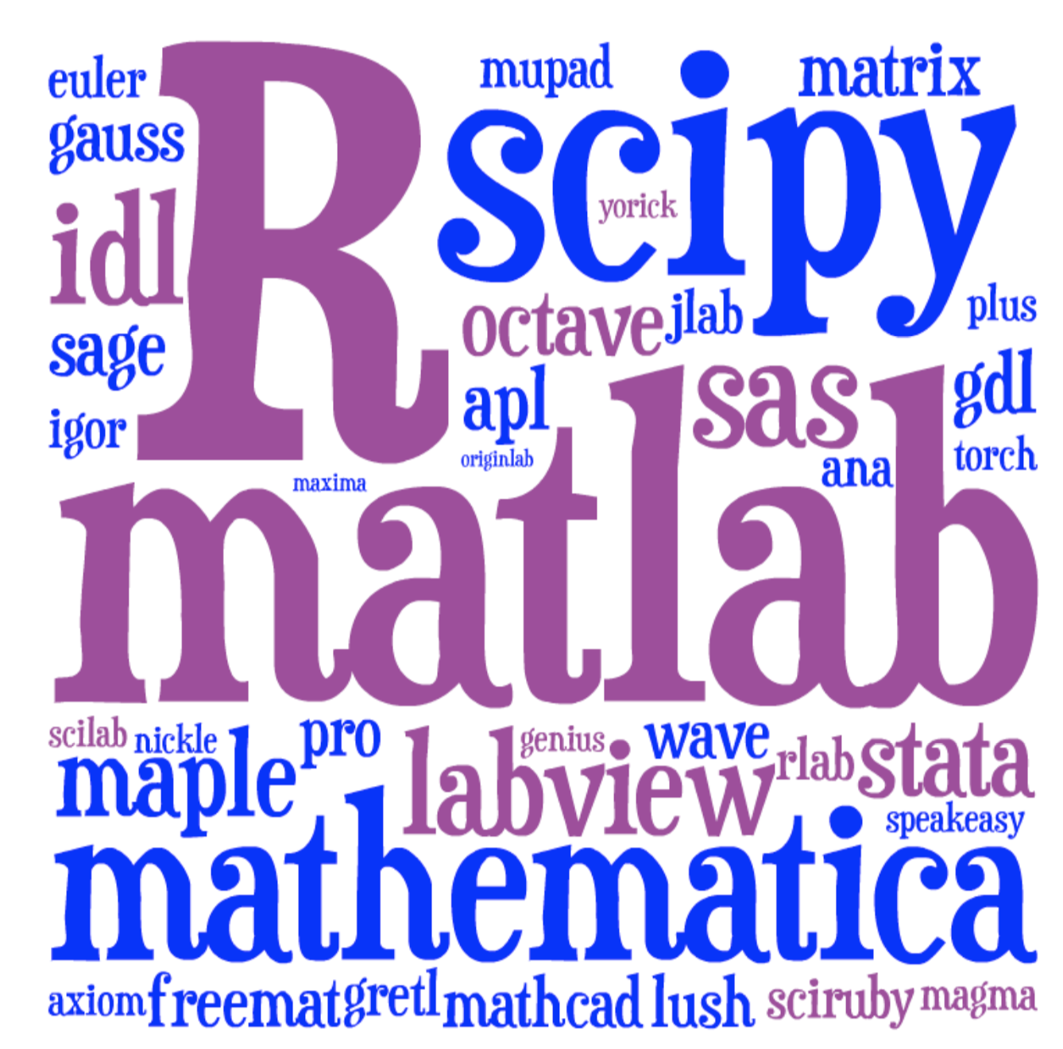
Lots of choices for interactive math…
[ image: Viral Shah ]

Slide 4
Just pick the most popular? Matlab or Python or R?
We must often use another a language for our “real work”.
Traditional HL computing languages
hit a performance wall in “real” work
… eventually force you to C, Cython, Fortran, Numba…

Slide 5
(Also, it’s always good to learn another programming language. If you only know one language, it’s easy to confuse the concepts for the syntax. And each language you learn makes the next language much easier.)

Slide 6





A new programming language?
Viral Shah
Jeff Bezanson
Alan Edelman
[ MIT ]
julialang.org
Stefan Karpinski
[begun 2009, “0.1” in 2013, ~50k commits,
1.0 release in 2018, 1.10 in Dec. 2023 ]
[ 60+ developers with 100+ commits,
10,000+ external packages, 11th JuliaCon in 2024 ]
As high-level and interactive as Matlab or Python+IPython,
as general-purpose as Python,
as productive for technical work as Matlab or Python+SciPy,
but as fast as C.

Slide 7
Lots of performance discussions, benchmarks, tutorials online… Let’s just look at one simple example.

Slide 8
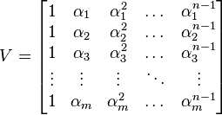
Generating Vandermonde matrices
given x = [α₁, α₂, …], generate:
NumPy (numpy.vander): [follow links]
Python code …wraps C code
… wraps generated C code
type-generic at high-level, but
low level limited to small set of types.
Writing fast code “in” Python or Matlab = mining the standard library
for pre-written functions (implemented in C or Fortran).
If the problem doesn’t “vectorize” into built-in functions,
if you have to write your own inner loops … sucks for you.

Slide 9
Vandermonde matrices: Julia vs NumPy
function vander(x, n=length(x))
m = length(x)
V = Array{eltype(x)}(undef, m, n)
for j = 1:m
V[j,1] = one(x[j])
end
for i = 2:n
for j = 1:m
V[j,i] = x[j] * V[j,i-1]
end
end
return V
end
note: works for any container
of any type with “*” operation
… performance ≠ inflexibility
NumPy-1.18 time / Julia-1.5 time

Slide 10
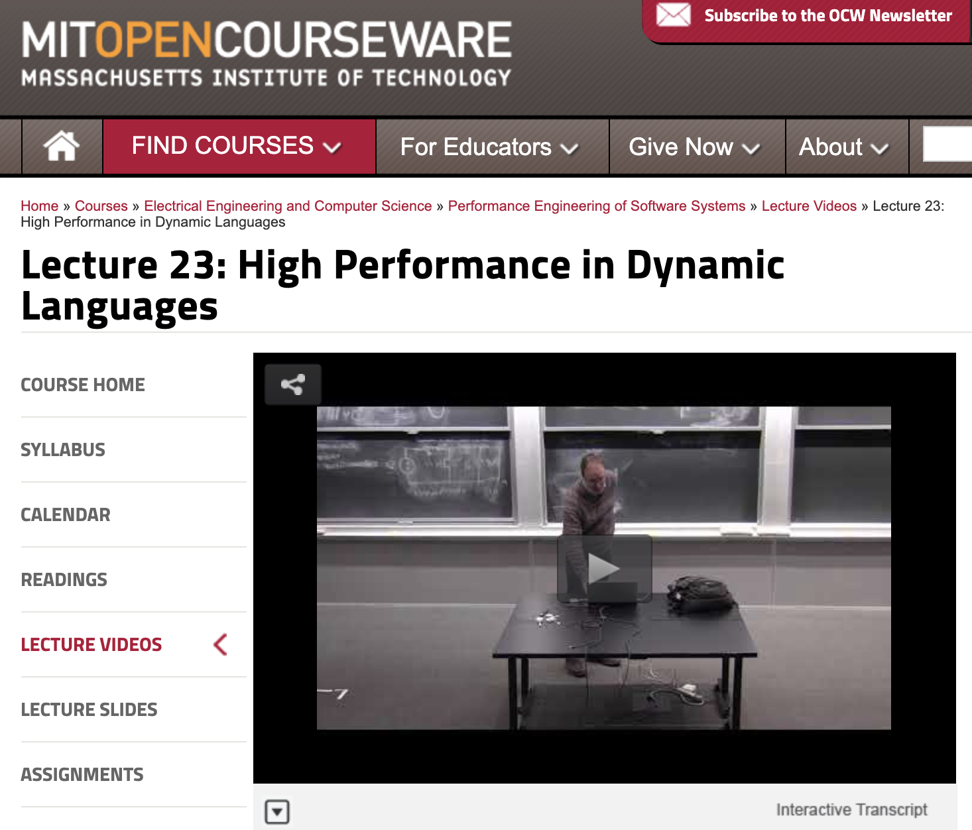
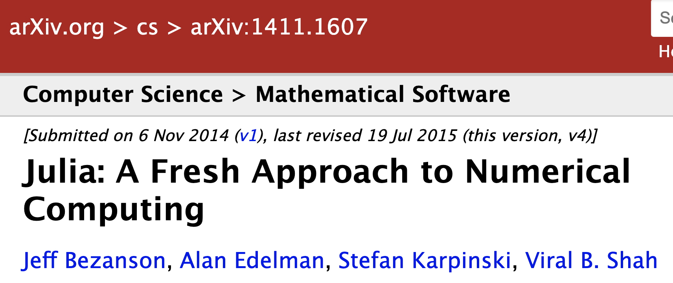
Why is Julia fast? A topic for another day.
See my 6.172 “guest lecture”
from 2018:
https://bit.ly/2QUrgB4
The original paper:

Slide 11
But I don’t “need” performance!
For lots of problems, especially “toy” problems in courses, Matlab/Python performance is good enough.
But if use those languages for all of your “easy” problems, then you won’t be prepared to switch when you hit a hard problem. When you need performance, it is too late.
You don’t want to learn a new language at the same time that you are solving your first truly difficult computational problem.

Slide 12
Just vectorize your code? = rely on mature external libraries, operating on large blocks of data, for performance-critical code
Good advice! But…
• Someone has to write those libraries.
• Eventually that person will be you.
— some problems are impossible or
just very awkward to vectorize.

Slide 13
But everyone else is using Matlab/Python/R/…
Julia is still a young, niche language. That imposes real costs — lack of familiarity, rough edges, fewer external packages. These are real obstacles.
But it also gives you advantages that Matlab/Python users don’t have.

Slide 14
But I lose access to all the libraries available for other languages?
Very easy to call C/Fortran libraries from Julia, and also to call Python…

Slide 15
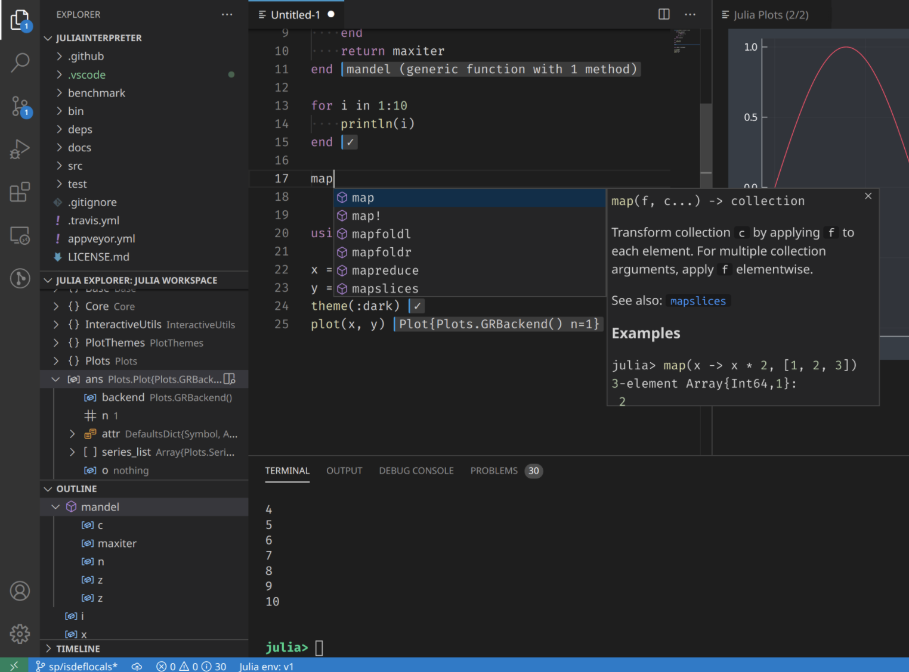
Julia Coding Environments
Of course, full-featured “IDE” coding environments are available with VSCode, Atom, not to mention Emacs, Vim, …
and Julia has the usual features for organizing large programs into files, data structures, modules…
+ integrated hypertext documentation support…
+ built-in github-integrated package manager for distributing & installing packages and dependencies…
Julia + VSCode
… but today we’re only looking at interactive snippets of code:
Julia as a “glorified calculator.”

Slide 16
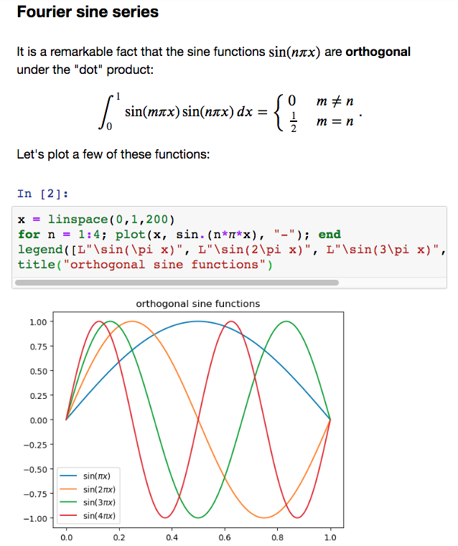

Julia Interactive-Computing Environments
Jupyter notebooks:
code+text+
equations+images+…
+ Julia backend
= IJulia

